Slide 1





ACO
Erasure Coding
WITH
Instructor: Prof. Priyanka Bagade
Group 1
Maurya Aryan Swaminath (210595)
Depanshu Sahu (210316)
Aditya Ajmera (210056)

Slide 2
Problem Statement
Achieving both data reliability and energy efficiency in routing remains a critical challenge IoT networks. As IoT devices typically operate with limited power resources, optimizing energy consumption is essential for extending network lifespan. However, this must be balanced with ensuring reliable data transmission, as packet loss during communication can compromise the overall performance and integrity of the network. Therefore, the key issue is to develop a routing protocol that minimizes data loss while maintaining energy efficiency during data transmission.
2

Slide 3
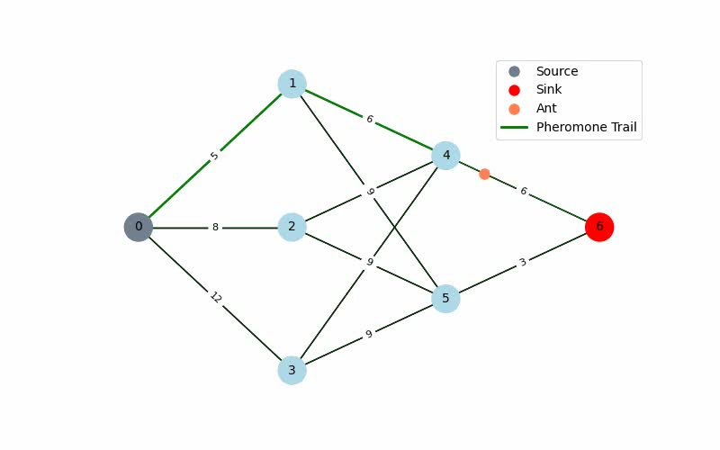
ACO Algorithm Overview
3

Slide 4
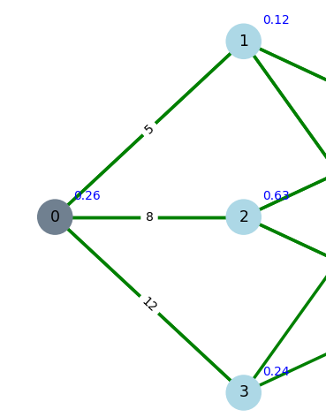
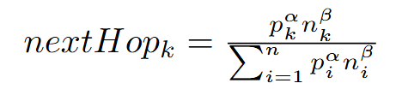
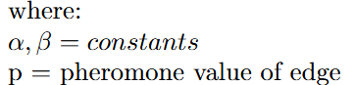
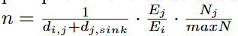
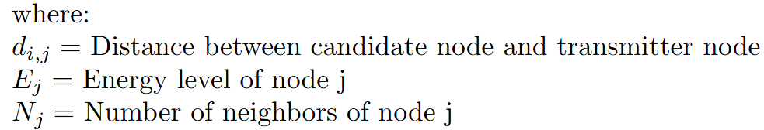
Ant Next Hop Selection
Next hop probability for an ant is given by the formula:
4

Slide 5
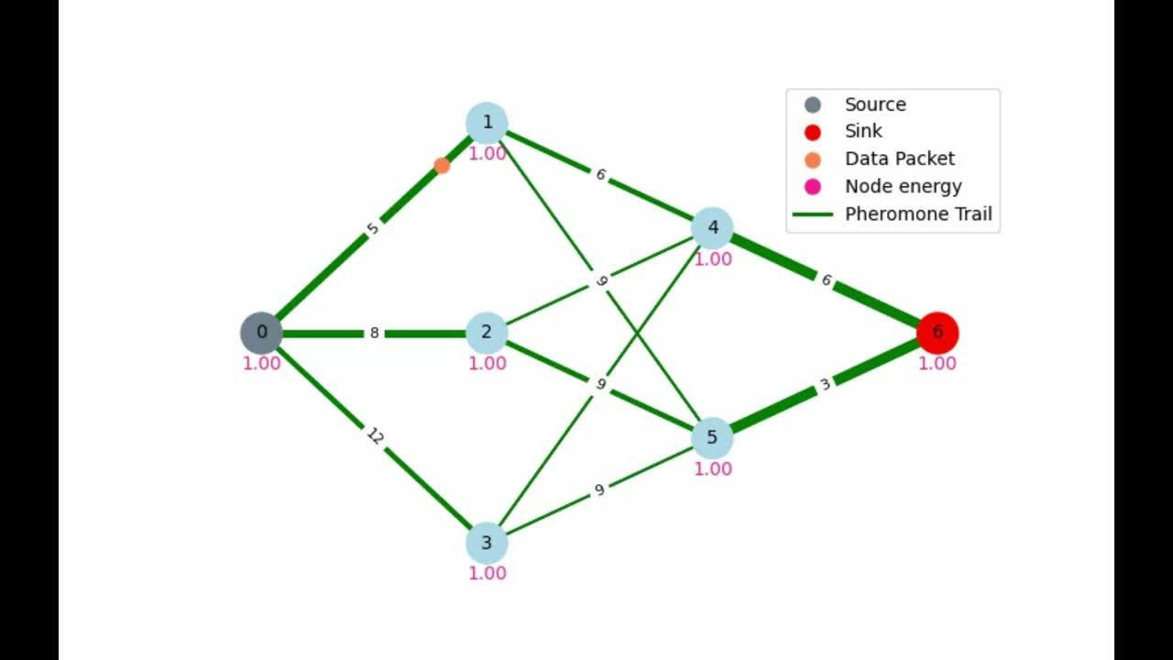
Sending Data in ACO
5

Slide 6
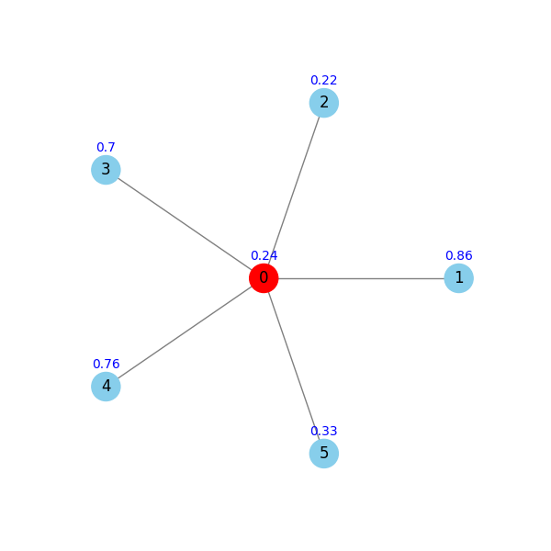
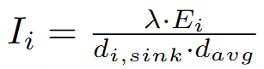
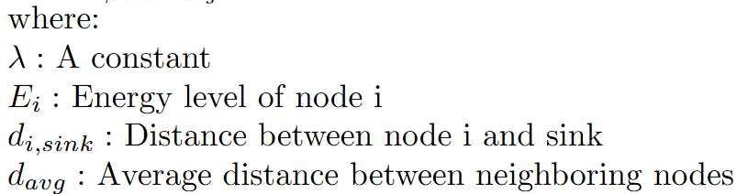
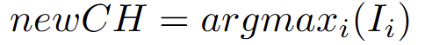
Cluster Head Selection
When the energy of the node is less than half of the energy of the surrounding node, an update cluster head algorithm is run which decides the new cluster head based on the formula:
The node which has highest I values is chosen as the new CH
6

Slide 7
Erasure Coding Comparison
File size: 39 kB
Data blocks: 100
Parity blocks: 20
Total blocks: 120
Assumptions:
XOR: ~ 0.1 pJ
Addition: ~ 0.1 pJ
Multiplication: ~ 3 pJ
Process | XORs | ADD | MUL | Energy Used (µJ)
Reed-Solomon Encoding | 798,840 | 798,840 | 798,840 | 2.556288
Reed-Solomon Decoding | 866,840 | 866,840 | 866,840 | 2.773888
Cauchy Encoding | 800,000 | 0 | 0 | 0.080000
Cauchy Decoding | 800,000 | 0 | 0 | 0.080000
7

Slide 8
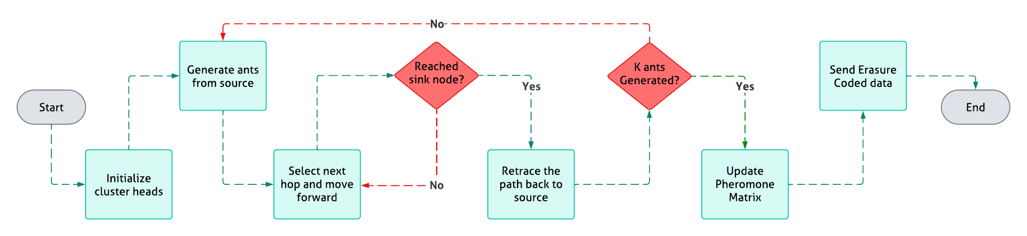
Summary of EC-ACO algorithm
Periodically send ants to update the pheromone matrix
Update Cluster Head after energy is less than threshold (half of Average)
8

Slide 9
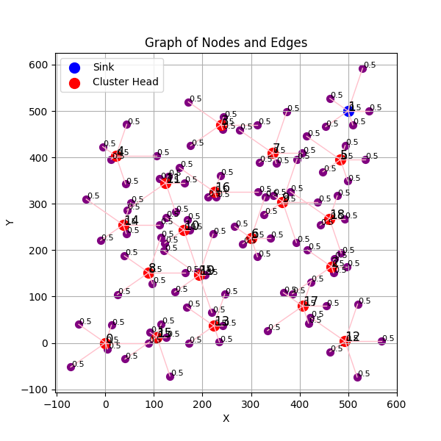
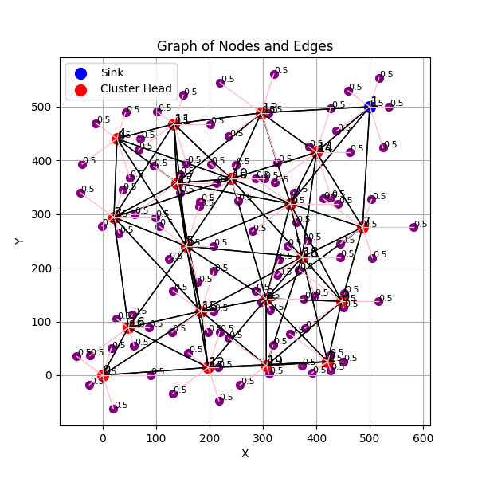
Network Topology
9

Slide 10
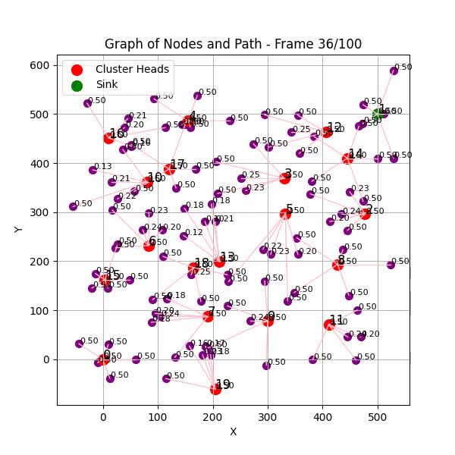
EC-ACO Demo: CH timelapse
10

Slide 11
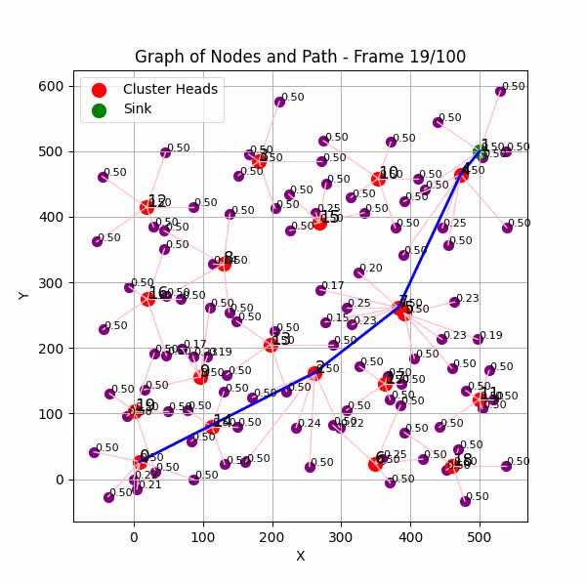
EC-ACO Demo: Optimal Path Evolution
11

Slide 12
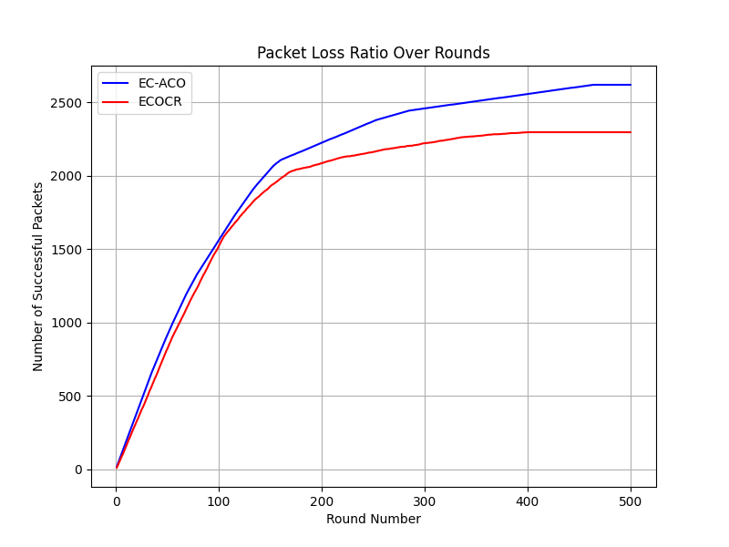
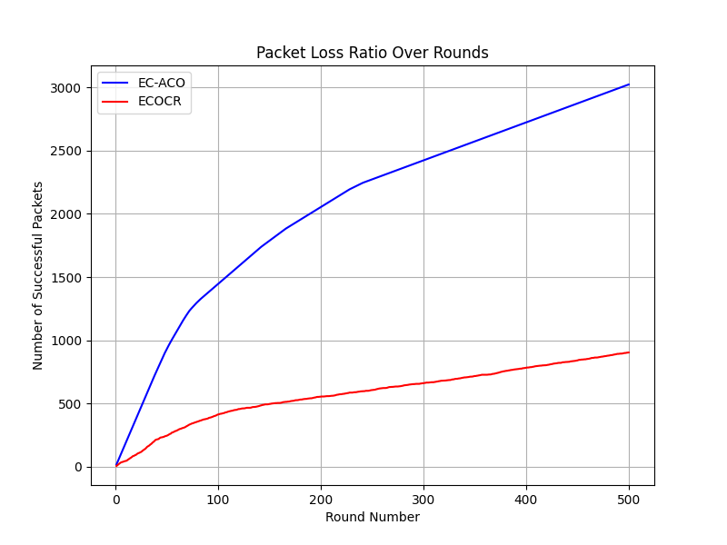
Reliable Data Packet Comparison
0% to 10% packet loss on each node
Data blocks: 10
Parity blocks: 2
Total blocks: 12
Data blocks: 100
Parity blocks: 20
Total blocks: 120
12

Slide 13
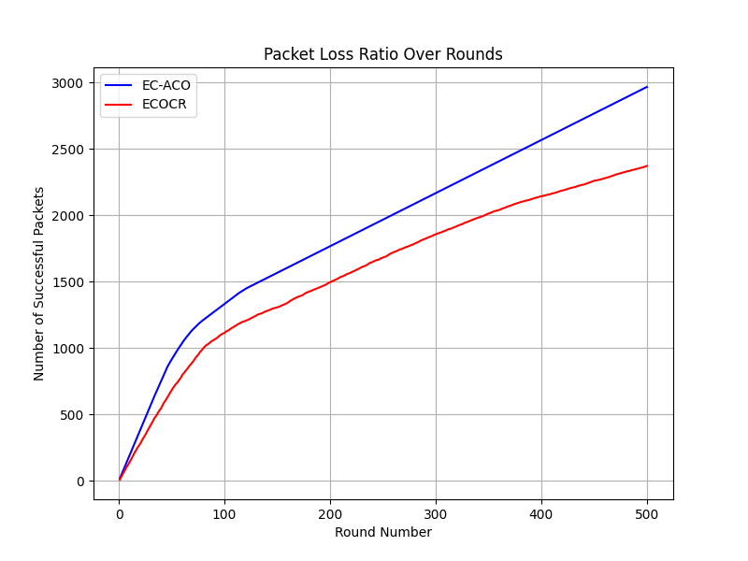
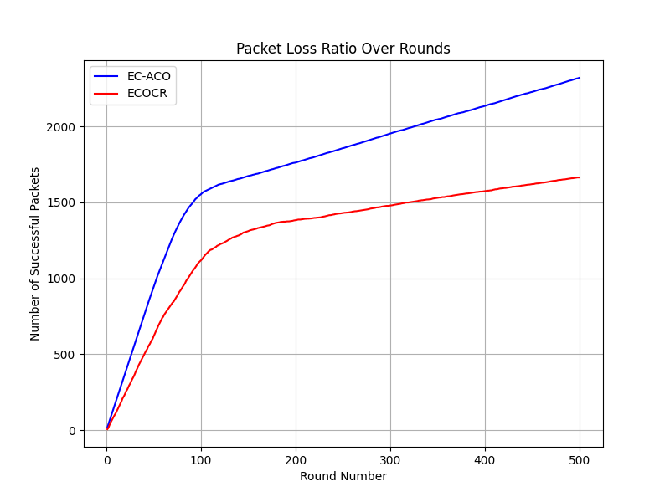
Reliable Data Packet Comparison
0% to 15% packet loss on each node
0% to 20% packet loss on each node
Data blocks: 10
Parity blocks: 2
Total blocks: 12
Data blocks: 10
Parity blocks: 2
Total blocks: 12
13

Slide 14
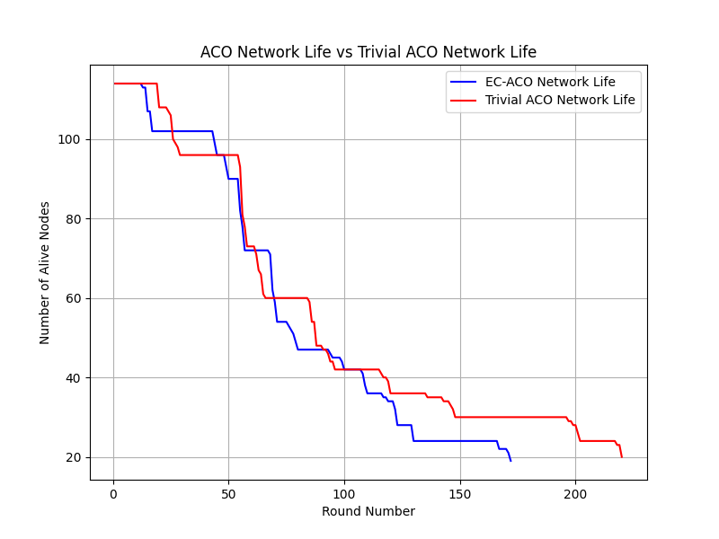
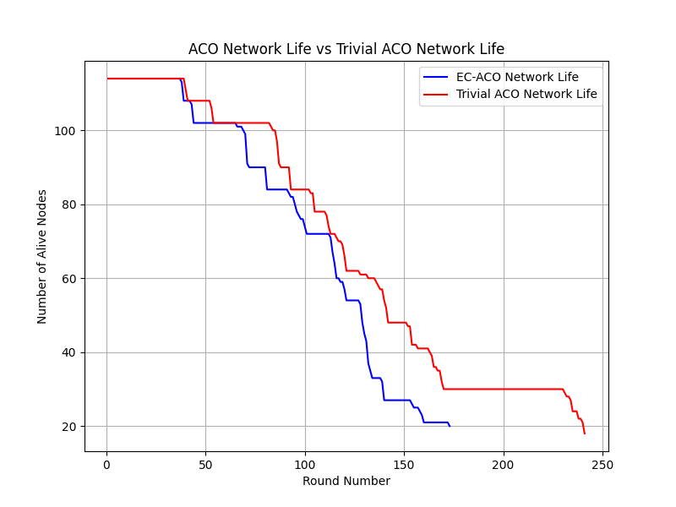
Network Lifetime Comparison
Note: Tested for QoS : 0 (At most once)
0% to 10% packet loss on each node
EC-
Data blocks: 10
Parity blocks: 2
Total blocks: 12
Data blocks: 100
Parity blocks: 20
Total blocks: 120
14

Slide 15
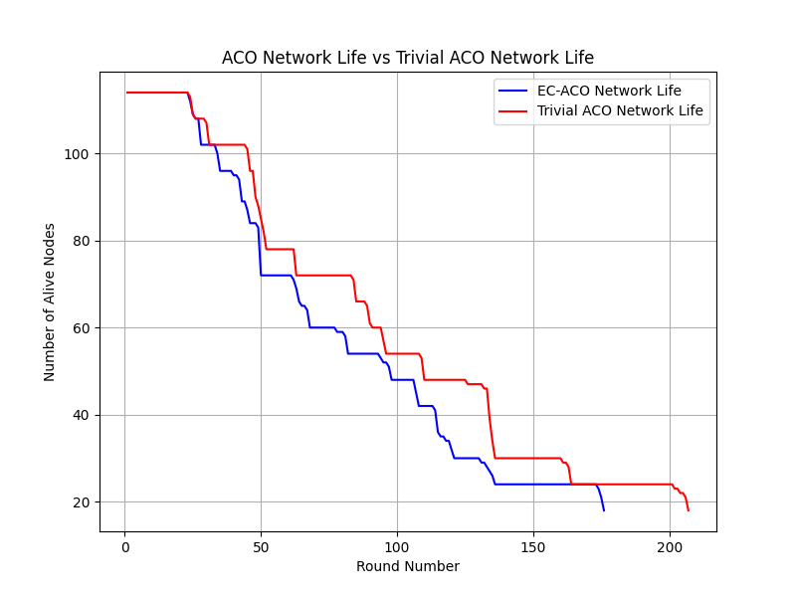
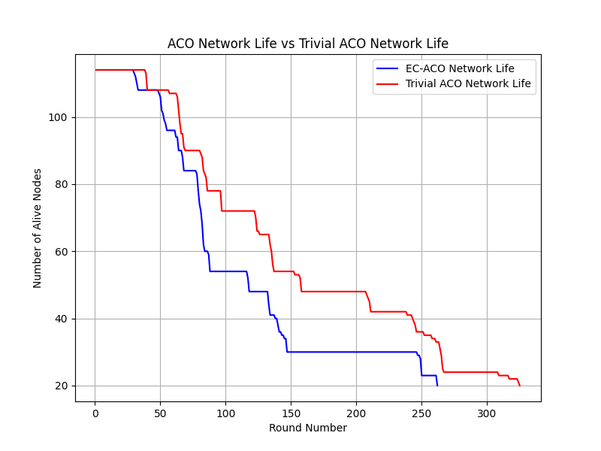
Network Lifetime Comparison
0% to 15% packet loss on each node
0% to 20% packet loss on each node
EC-
EC-
EC-
EC-
Data blocks: 10
Parity blocks: 2
Total blocks: 12
Data blocks: 10
Parity blocks: 2
Total blocks: 12
15

Slide 16
Conclusion
Integration of Cauchy Reed-Solomon Erasure Coding significantly reduces packet loss, enhancing data reliability in IoT networks
Improved data reliability is achieved at a cost of network lifetime, offering a controlled trade-off suitable for critical IoT applications
Extent of erasure coding can be adjusted based on network loss
Cluster Head selection based on residual energy helps distribute energy consumption across nodes, extending network lifespan
ACO’s adaptive design efficiently finds optimal, energy-saving paths for dynamic IoT networks
16

Slide 17
Challenges Faced
Implementing Basic Ant Colony Optimization (ACO)
Developing an Energy-Efficient ACO with Cluster Head (CH) Selection
Integrating Erasure Coding into the Algorithm
Understanding metrics for algorithm comparison
Implementing BOA algorithm
Comparing BOA with our algorithm
17

Slide 18
Contribution
TASK | DONE BY
Random Network Topography Generation | MA, AA
Trivial ACO Implementation | MA, DS
Energy-Efficient Next-Hop Selection | DS
Erasure Coding During Data Transmission | MA, AA
Erasure Coding Techniques | AA
Cluster Head Selection Mechanism | DS
Comparing Data Loss in a Lossy Network | MA
Comparing Network Lifetime | MA, AA
Presentation | MA, DS, AA
Final Report | MA, DS, AA
Final Contribution % | Final Contribution %
Maurya Aryan Swaminath (MA) | 33.33
Depanshu Sahu (DS) | 33.33
Aditya Ajmera (AA) | 33.33
18

Slide 19
Deliverables
Python code for the algorithm implementation
Detailed report on the algorithm and its performance
Simulation video demonstrating the algorithm in action
Energy-efficient and data reliability comparisons with metrics
19

Slide 20
Thank
You

